Slide 1







<Predicting breast cancer patients living status after 5 years>
<Yudy Yunardy>
<13 December 2021>
Notes:
Hello my name is Yudy and this is my Capstone project for IBM Advanced Data Science, I will be presenting about predicting breast cancer patients living status after 5 years.

Slide 2
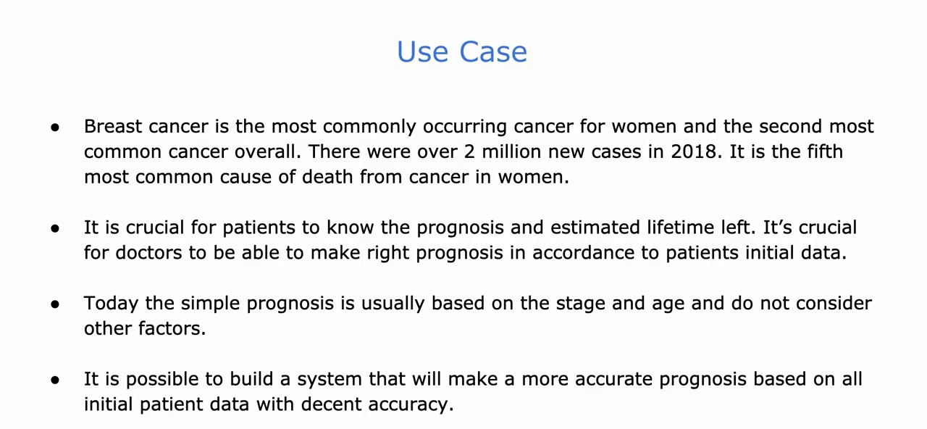
Notes:
The use case are following, as we all know that breast cancer is the most commonly occurring cancer for women and the second most common cancer overall. And we see that there were over 2 million new cases in 2018. It’s the fifth most common cause of death from cancer in women.

Slide 3
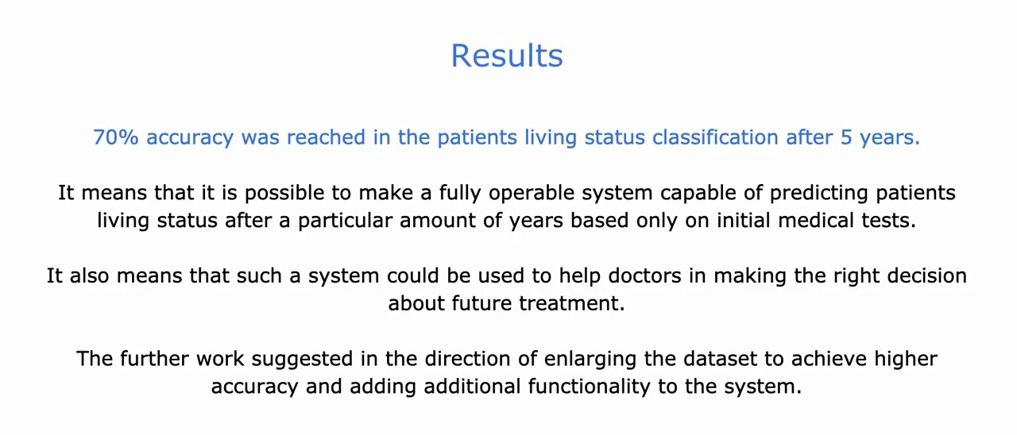
Notes:
The result from this project is 70% accuracy for patients living status classification after 5 years.

Slide 4
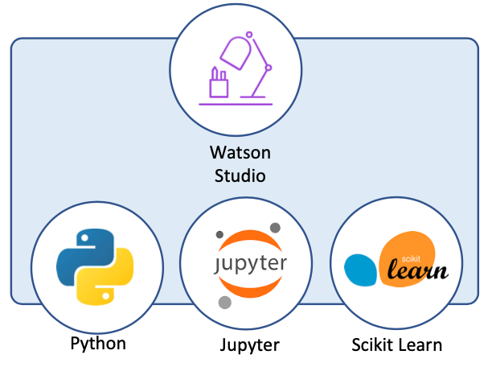
Architecture
Technologies
Python
Jupyter
Pandas
Sklearn
Keras
Matplotlib, Seaborn
Apache Spark
Notes:
The architecture being used is IBM Watson Studio with Jupyter notebooks in Python and Apache Spark, and the libraries used are Pandas, Scikit-learn, Keras, Matplotlib, Seaborn

Slide 5
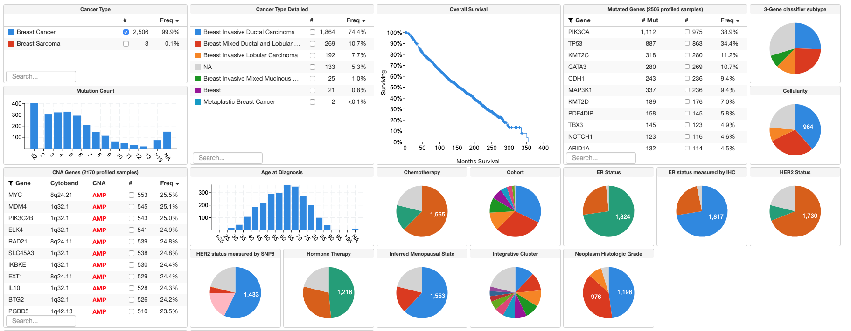
Dataset
Breast Cancer Dataset (METABRIC, Nature 2012 & Nat Commun 2016) from The cBioPortal for Cancer Genomics - targeted sequencing of 2509 primary breast tumors
Notes:
The dataset being used is breast cancer dataset from cBioPortal for cancer genomics, with targeted sequencing of 2509 primary breast tumors

Slide 6
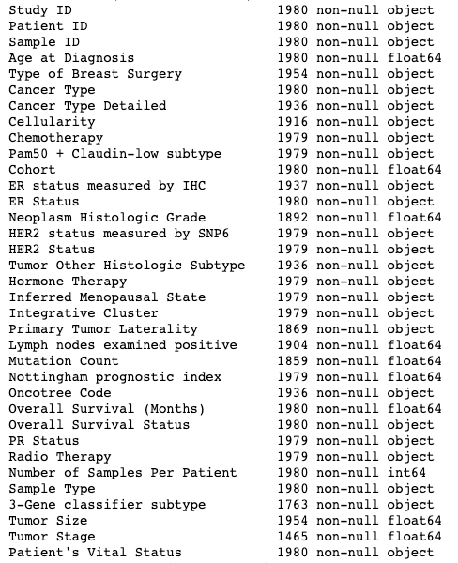
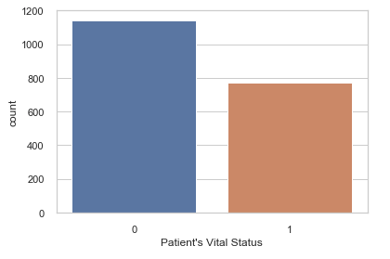
Dataset
A lot of missing values
Mixed patients data
Numerical features are skewed
Prediction classed are imbalanced
Notes:
I will put the raw dataset in my Github but you can also visit the cBioPortal with included link in this documents or in ADD. As you would see from the dataset that there is a lot of missing values, and this is usual for real world data, also there is mixed patients data. And you would see in my notebook that this data numerical features are skewed, and predictions classes are imbalanced.

Slide 7

Preprocessing
Data cleaning
Filling missing values
Uniting
Transformation
Splitting
One-Hot encoding
Scaling
Notes:
First we will clean the data, fill the missing values and then transform the data, split the test and train data, then one hot encoding, scaling the data, and join them.

Slide 8
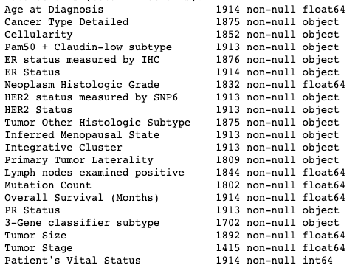
Data Cleaning
Notes:
In cleaning the data I also drop the unnecessary column in order to increase the performance of the model, and here we see that the right side is the result of cleaned data or just the necessary fields to build the model.

Slide 9
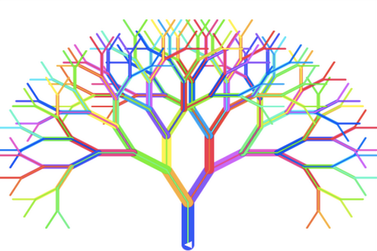
Filling missing values
Dropping columns
1758 rows
Dropping NaNs
1120 rows
Imputing
1825 rows
Notes:
Here I try 3 alternatives, first is by dropping columns, for example if we drop tumor stage column, we could get rid of around 400 missing values from that column and in result we would get 1758 rows. And if we drop all the NaNs we will get 1120 rows, and this is too small compared to other alternatives. Last alternative is imput the features with random forest and we will get 1825 rows.

Slide 10
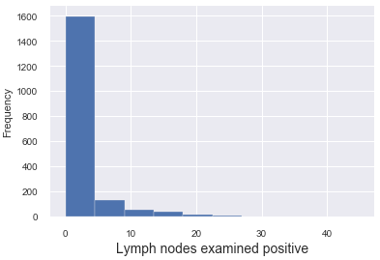
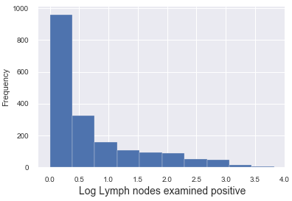
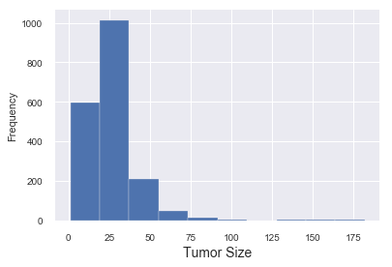
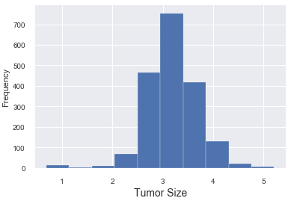
Transformation
log(x+1)
log(x+1)
Notes:
A: log(x+1) transformation is often used for transforming data that are skewed, and also include zero values.

Slide 11
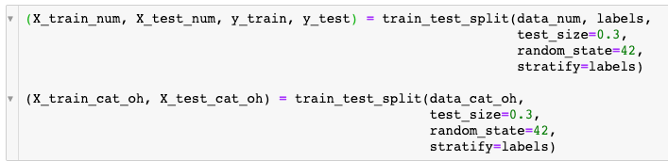
Splitting
Notes:
Then the dataset will be splitting into train and test data.

Slide 12
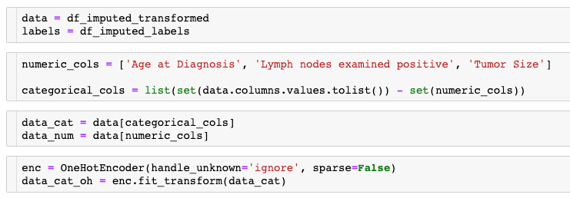
One-Hot Encoding
Notes:
In digital circuits and machine learning, a one-hot is a group of bits among which the legal combinations of values are only those with a single high bit and all the others low.

Slide 13

Scaling
Notes:
Feature scaling is a method used to normalize the range of independent variables or features of data.

Slide 14
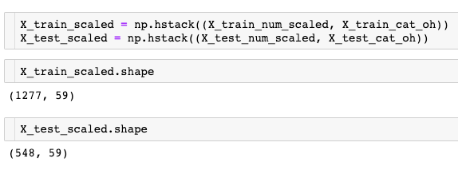
Uniting
Notes:
And lastly we would unite the data of train and test data.

Slide 15
Algorithm selection
Algorithm | Accuracy
Random Forest | 64%
Gradient Boosting | 69%
Bernoulli Naive Bayes | 64%
Logistic Regression | 74%
SVM | 73%
KNN | 65%
MLP | 66%
Sequential NN | 65%
Notes:
Support vector machines (SVMs) are a set of supervised learning methods used for classification, regression and outliers detection. The advantages of support vector machines are: Effective in high dimensional spaces. Still effective in cases where number of dimensions is greater than the number of samples.
A multilayer perceptron (MLP) is a class of feedforward artificial neural network (ANN).

Slide 16
Iterations
AUROC | Train | Test
Model without normalization | 0.705 | 0.663
Normalization done | 0.725 | 0.686
Feature selection (49 -> 40) | 0.724 | 0.686
Param Tuning | 0.775 | 0.692
Feature Imputation | 0.754 | 0.740
Notes:
The area under the receiver operating characteristic (AUROC) is a performance metric that you can use to evaluate classification models.

Slide 17
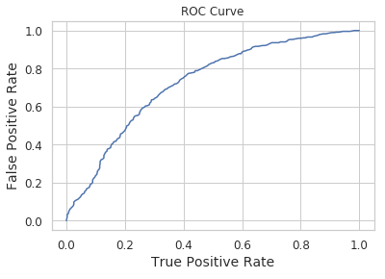
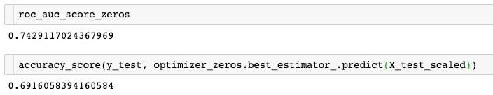
Result
Notes:
And the result of receiver operating characteristic or ROC curve is as follows

Slide 18


